Slide 1
20 YEARS OF SCIENTIFIC RESEARCH IN HEALTH/WORK/ENVIRONMENT Balance and perspective ... dialogue between the stakeholders. September 6, 2012 CONTEXT, OBJECTIVES and ACHIEVEMENTS
Sybille van den Brule
Louvain centre for Toxicology and Applied Pharmacology Université catholique de Louvain

Slide 2
The role of BELSPO in the national research on Health & Environment
RESEARCH
Universities
Industries
Milieu en
Gezondheid
Institute of Public Health
(ISP-WIV)
Health and Environment
FUNDING
Fundamental
Translational research
Independent from industries
Multidisciplinary
FWO
FRS-FNRS
BELSPO
IWT
FRIA
INNOVIRIS
medical
Applied
(innovation and technology)
FRSM

Slide 3
History of H&E research at BELSPO till 2003
Period | Program | Budget | Number of projects | Project distribution
1990-1994 | Health risks: environment | 12 MEUR | 21 | 17 in toxicology and environmental health 4 in ergonomics
1994-1998 | Scientific support program for health protection of workers | 7.2 MEUR | 16 | 9 in toxicology and environmental health 3 in ergonomics 4 on psychosocial risks
1998-2000 | Scientific support program for protection of workers phase I | 7.2 MEUR | 11 | 6 in toxicology and environmental health 2 in ergonomics 3 on psychosocial risks
1999-2003 | Scientific support program for protection of workers phase II | 7.7 MEUR | 9 | 4 in toxicology and environmental health 2 in ergonomics 3 on psychosocial risks
SPOª
OSTC^{b}
ª SPO: Science Policy Office
^{b} OSTC: federal Office for Scientific, Technical and Cultural affairs

Slide 4
BELSPO programs in H&E from 1990 till 2010
User and political needs
Scientific potential in Belgium
New technologies
European directives
1990-94
Health risks:
environment
Health risks:
identification and evaluation
Toxicology and
environmental health
Ergonomics
News methods
Data banks
1994-98
Health protection of workers
- Risks for workers:
identification and evaluation
Multidisciplinary approach
Socio-economical factors
Method validation
Establishment of standards
Toxicology and
environmental health
Ergonomics
Psycho-social risks
Phase 1(1998-2000)
Phase 2 (1999-2003)
Protection of workers
Consideration of legal and
ethical factors
- Data valorization
2006-2010
Science for a Sustainable
Development (SSD)
- Sustainable development
Support to the authorities
EU and national directives :
environment, mobility,
multidisciplinary approach
- Internationalization
Strengthening of the scientific
potential
- Populations at risk
Effects of the environment
on health:
Nanomaterials
Indoor and outdoor
air quality
Consortium of multidisciplinary
education
Strengthening of Belgian
research quality
Internationale dissemination
Recommendations in support
of the authorities
8 thematics
E
N
E
R
G
Y
T
R
A
N
S
P
O
R
T
A
G
R
O
-
F
O
O
D
C
L
I
M
A
T
E
B
I
O
D
I
V
E
R
S
I
T
Y
A
T
M
O
S
P
H
E
R
E
T
R
A
N
S
V
E
R
S
A
L
H
E
A
L
T
H
/
E
N
V
I
R
R
E
S
E
A
R
C
H
PROGRAMS
OBJECTIVES
THEMATICS
RESULTS

Slide 5
Determinants and objectives of SSD
Towards a sustainable development
social
economic
environment
International context:
Promote basic and targeted
research
Multidisciplinary approach
Incorporate an environmental
dimension
National context:
Support for research
Health-environment
Mobility
Employment
Economic growth
Science for a Sustainable
Development
SSD
E
N
E
R
G
Y
T
R
A
N
S
P
O
R
T
A
G
R
O
-
F
O
O
D
C
L
I
M
A
T
E
B
I
O
D
I
V
E
R
S
I
T
Y
A
T
M
O
S
P
H
E
R
E
T
R
A
N
S
V
E
R
S
A
L
H
E
A
L
T
H
/
E
N
V
I
R
R
E
S
H
E
A
R
C
H
Strengthening of the scientific potential
Scientific support to the authorities
International integration of the Belgian research

Slide 6
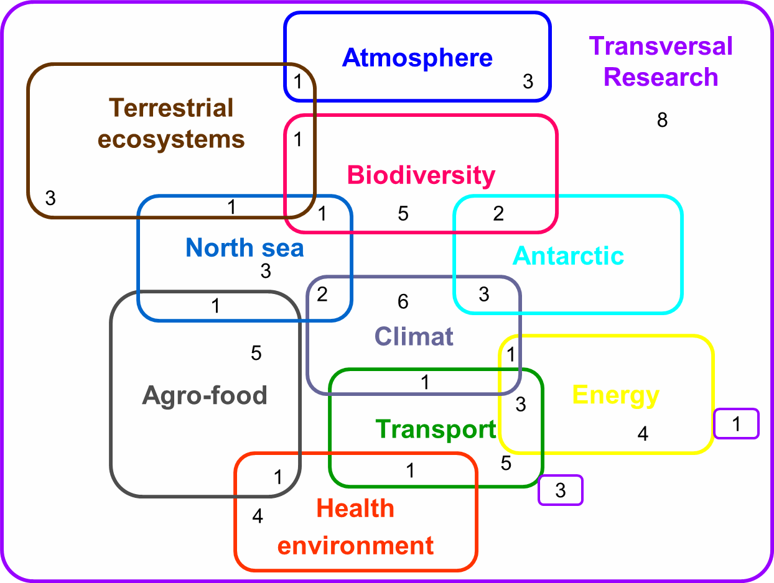
SSD thematics and synergies
H&E
7 % Budget
Budget
Total ± 60.000 K euro

Slide 7
Objectives of the SSD program
To integrate EU and national directives (environment, mobility, …)
To preserve and develop the scientific potential in various strategically important areas
To integrate the principles of sustainable development in research
To promote interdisciplinary research
To enable the integration of scientists in international research programs and networks
To provide a scientific support for a sustainable policy
To promote communication between researchers, decision-makers and society
To promote collaboration between projects
Follow-up
committee
Clusters
of projects
Objectives of H&E research in the SSD program
Influence of environmental factors on human health
Known issues: air and water pollutions, chemicals, …
New issues: nanomaterials, pharmaceutical drug release in the environment, …
Effect of specific and mixed exposures
Identify biomarkers of effects
Identify short and long term effects (future generations…)
Identify populations at risk (children, elderly, …)
Study socio-economical impacts of health risks
…
INDOOR AND OUTDOOR
AIR QUALITY

Slide 8
SSD projects and clusters in H&E
Project or cluster | Code | Promoteurs | Institutions | Budget
PARHEALTH - Health effects of particulate matter in relation to physical-chemical characteristics and meteorology | SD/HE/01A | Benoît Nemery Tim Nawrot Alfred Bernard Herman Van Langehove René Van Grieken Hugo De Backer Frans Fierens | KUL KUL UCL Ugent UA RMI Ircel | 799.730€
SHAPES - Systematic analysis of Health risks and physical Activity associated with cycling PoliciES | SD/HE/03A | Luc Int Panis Romain Meeusen Isabelle Thomas | VITO VUB UCL | 797.672€
PM2TEN - Particles, Mobility, Physical activity, Morbidity and The Environment Network | SD/CL/02 | Luc Int Panis Romain Meeusen Benoit Nemery Tim Nawrot | VITO VUB KULeuven KULeuven | 99.402€
S²NANO - Physico-chemical determinants of toxicity: A rational approach towards safer nanostructured materials | SD/HE/02A | Dominique Lison Micheline Volders Peter Hoet Johan Martens | UCL VUB KULeuven KULeuven | 798.069€
MIC-ATR - Development of a new low cost and regenerable detection device for microbial compounds | SD/HE/04A | Etienne Noël A. Van Cauwenberghe Joel De Coninck Kris Huygen Olivier Denis | Asbl HP en Hainaut Asbl HP en Hainaut UMH ISP-WIV ISP-WIV | 741.413€
ANIMO - Indoor risk factors for childhood respiratory diseases: development and application of non-invasive biomarkers | SD/HE/05A | Greet Schoeters Bernard Alfred Krisine Desager | VITO UCL UA | 765.002€
AIR QUALITY - Integration of existing approaches toward (bio)surveillance in relation with indoor and outdoor air quality | SD/CL/04 | Anne Vancauwenberge Rosette Van Den Heuvel Luc Int Panis Tim Nawrot Benoit Nemery | Asbl HP en Hainaut VITO VITO KULeuven KULeuven | 99.990€
Identify particles and compounds potentially toxic
in the indoor and outdoor environment
Determinants of this toxicity?
Sensitive detection and quantification
Identify effect biomarkers (early and non-invasive)
Study populations at risks

Slide 9
Achievements of SSD projects and clusters in H&E
Support for regulatory decisions (ex: PARHEALTH, SHAPES, MIC-ATR)
Orientation of future research (ex: Clusters PM2TEN and AIR QUALITY)
Creation of interdisciplinary consortiums (ex: S2NANO)
Development of new methods for detection, evaluation of toxicity, …
(ex: S2NANO, MIC-ATR)
Determinants of toxicity (ex: S2NANO)
Identification of biomarkers (ex: ANIMO)
Identification of environmental risk factors for pathologies (ex: ANIMO)
Integration into European projects (ex: S2NANO, ANIMO)
Dissemination of results in conferences, regulatory committees, …
and scientific peer-reviewed journals

